Slide 1
Word2Vector
Clebson C. Alves de Sá clebsonc@dcc.ufmg.br

Slide 2
Word2Vector
Models used to create “Word Embeddings”
  Neural Networks
  Dimensionality Reduction
  Probabilistic models
  …
Word Embeddings
  Word or phrases from a vocabulary mapped to a vector of real numbers

Slide 3
The Skip-gram Neural Network
Train a simple neural network with a single hidden layer to perform a certain task
This model is actually not used anywhere
  Just learn the weights of the hidden layer
  These weights are actually the “Word vectors”

Slide 4
The Skip-gram Neural Network
What the neural network does?
  Given a specific word in the middle of a sentence (the input word), look at the words nearby and pick one at random.
  The network is going to tell us the probability for every word in our vocabulary of being the “nearby word” that we chose.
    Nearby in the sense that there’s a window size

Slide 5
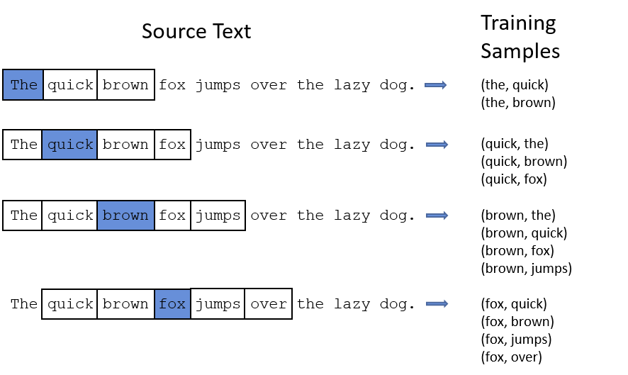
Window Size

Slide 6
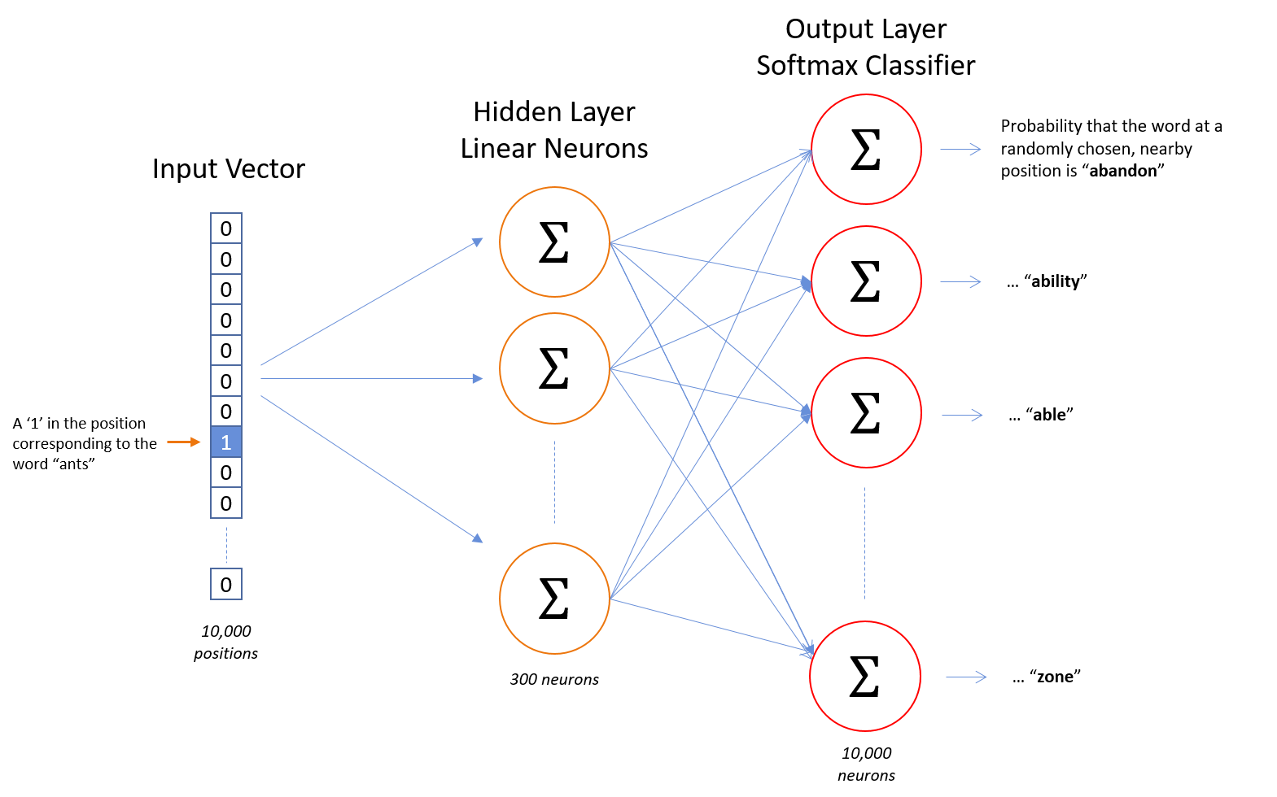
Model Architecture

Slide 7
The Skip-gram Neural Network
This implies that the model is trained to predict the probability of how semantically connected the words are. For example:
Input | Output
England | Queen
Soviet | Union, Russia
Kangaroo | Australian
Doll | Annabelle
Engine | Transmission

Slide 8
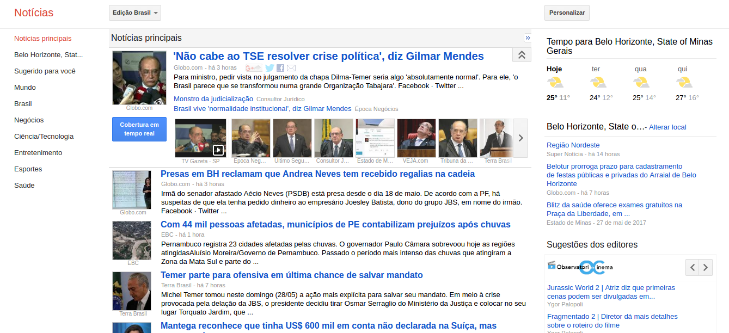
Google News

Slide 9
Google News as a Graph
3 million words and phrases
  Each word is a node
  Words are connected if there is a semantic meaning in the two words.

Slide 10
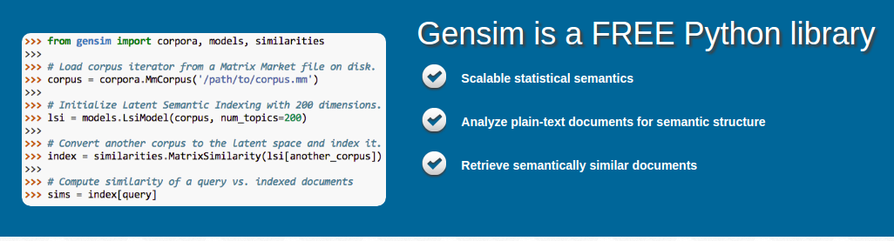
Gensim

Slide 11

Proposal
Characterize the network structure applying the network metrics that we have seen so far in the discipline
I’m going to use the following paper as a guide:

Slide 12
Word 2 Vector Model
Clebson C. Alves de Sá

